Slide 1
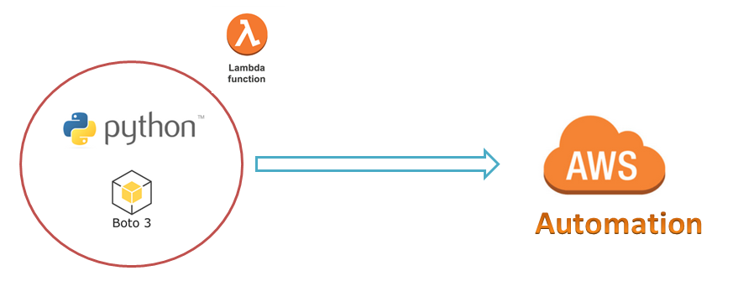
AWS Automation
with
boto3 of Python and Lambda Functions
Boto3 Concepts
Loop control statements or commands
(break and continue)
Learn how to automate AWS common tasks using boto3 and Lambda

Slide 2

Boto3 Concepts:
The core concepts of boto3 are:
Session
Resource
Client
Meta
Collections
Waiters
Paginators
Loop control statements or commands
(break and continue)
Learn how to automate AWS common tasks using boto3 and Lambda

Slide 3
Boto3 Concepts(session, resource and client)
Session:
It is an AWS Management Console in our terms.
stores configuration information (primarily credentials)
allows us to create service clients and resources
boto3 creates a default session for us when needed
Resource and Client:
We can create particular AWS Service Console like iam console, ec2 console, sns console…
Resource is higher-level object-oriented service access and it is available for some of the aws services.
Client is low-level service access
Loop control statements or commands
(break and continue)
Learn how to automate AWS common tasks using boto3 and Lambda

Slide 4
Thank you

